Slide 1
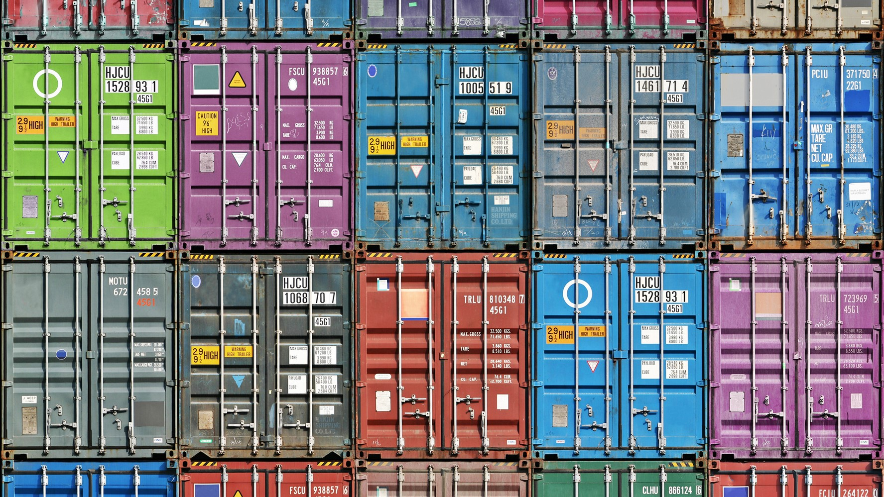
Docker Containers
Presentation by Marius Asadauskas & Julius Oeftiger
Fabrication and Prototyping in the Learning Lab
10.11.2022
Notes:
[image]: https://atlas-network.com/wp-content/uploads/2019/03/containers1-16.9.jpg

Slide 2
Timeline
Docker Basics
Docker Security
PiHole implementation

Slide 3
All problems in computer science can be solved by another level of indirection.
David Wheeler

Slide 4
It works on my machine but not theirs!
How to reduce IT costs
How to manage Dependencies

Slide 5
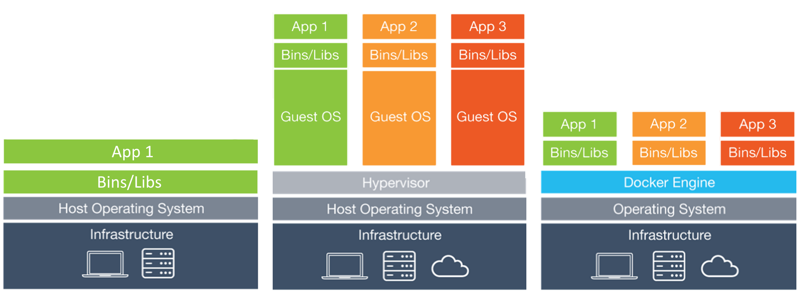
OS, Virtual Machines and Docker
Notes:
[Image]: https://stalk-calvin.github.io/img/20170415vd/docker.png

Slide 6
Docker Containers
Pros
Cons
Lightweight
Highly Portable
Efficient
Quick Bootup
Docker Pricing
Slight Overhead
Persistent Storage

Slide 7
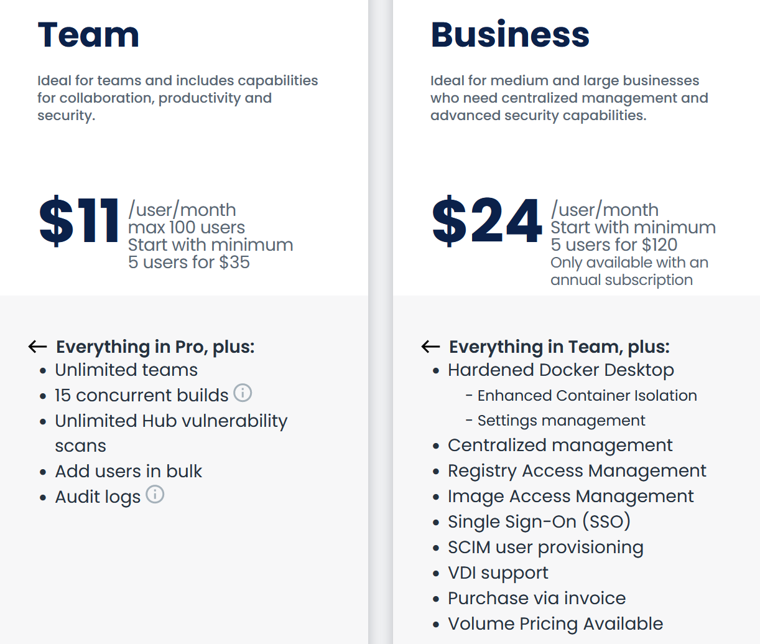
Pricing:
Notes:
[image]: https://www.docker.com/pricing/

Slide 8
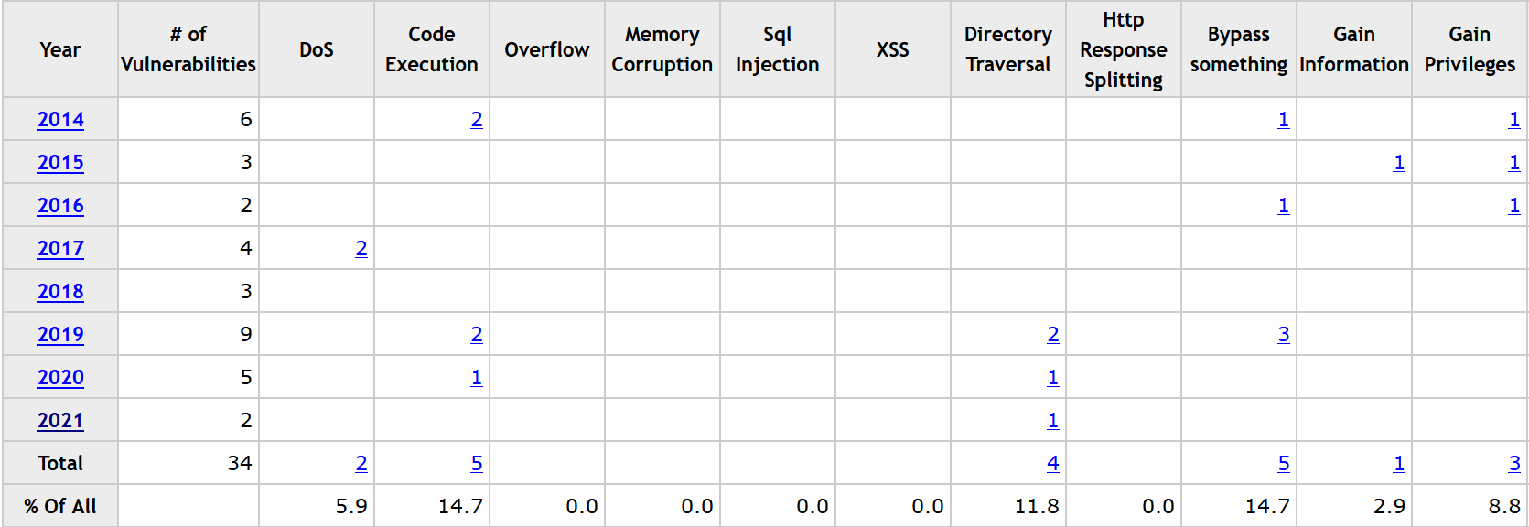
Security, Docker Vulnerabilities
Notes:
[Data]: https://www.cvedetails.com/product/28125/Docker-Docker.html?vendor_id=13534

Slide 9
Security
Subtitle
Subtitle
Add text, images, art, and videos.
Add transitions, animations, and motion.
Save to OneDrive, to get to your presentations from your computer, tablet, or phone.
Open the Design Ideas pane for instant slide makeovers.
When we have design ideas, we’ll show them to you right there.

Slide 10
Content
Subtitle
Subtitle
Add text, images, art, and videos.
Add transitions, animations, and motion.
Save to OneDrive, to get to your presentations from your computer, tablet, or phone.
Open the Design Ideas pane for instant slide makeovers.
When we have design ideas, we’ll show them to you right there.

Slide 11
Project: PiHole
Subtitle
Subtitle
Add text, images, art, and videos.
Add transitions, animations, and motion.
Save to OneDrive, to get to your presentations from your computer, tablet, or phone.
Open the Design Ideas pane for instant slide makeovers.
When we have design ideas, we’ll show them to you right there.

Slide 12
Thank you for Listening
Any questions?

